Slide 1
Chapter 4
The Processor
Notes:
Morgan Kaufmann Publishers
Chapter 4 — The Processor

Slide 2
Building a Datapath
Datapath
  Elements that process data and addresses
  in the CPU
    Registers, ALUs, mux’s, memories, …
We will build a MIPS datapath incrementally
  Refining the overview design
§4.3 Building a Datapath
Chapter 4 — The Processor — <number>
Notes:
Morgan Kaufmann Publishers
Chapter 4 — The Processor

Slide 3

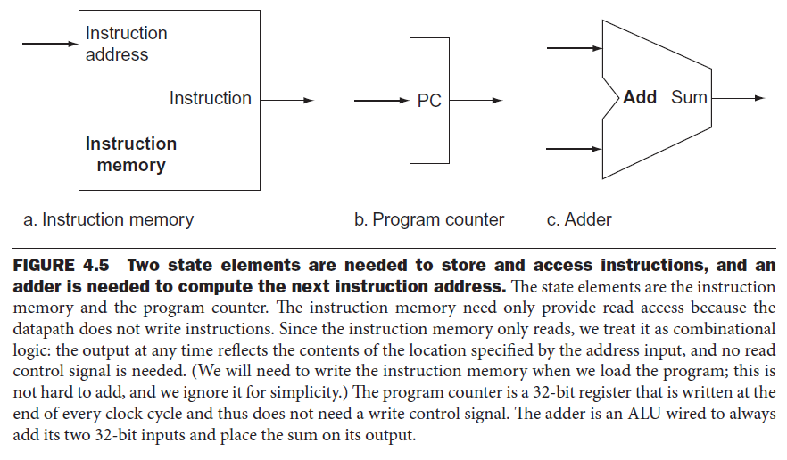
Elements needed to Store and Access Instructions
Chapter 4 — The Processor — <number>

Slide 4
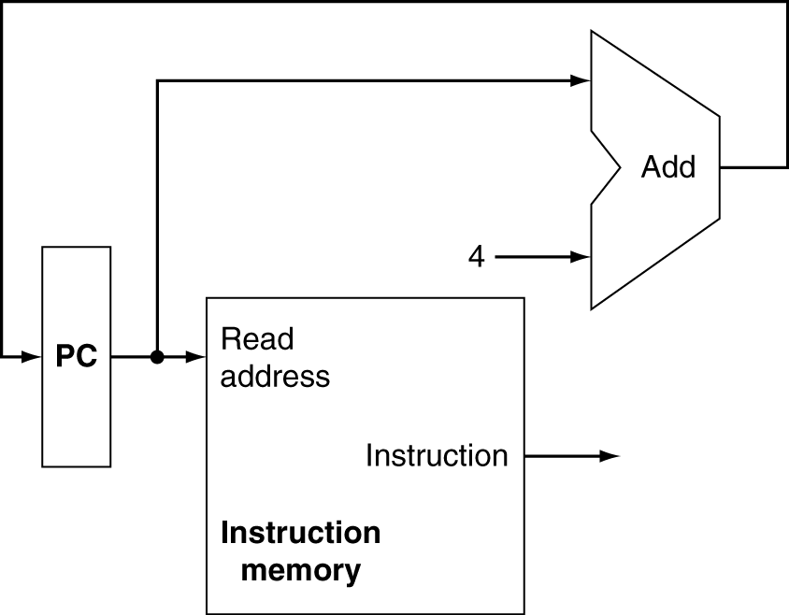
Instruction Fetch
Increment by 4 for next instruction
32-bit register
Chapter 4 — The Processor — <number>
Notes:
Morgan Kaufmann Publishers
Chapter 4 — The Processor

Slide 5
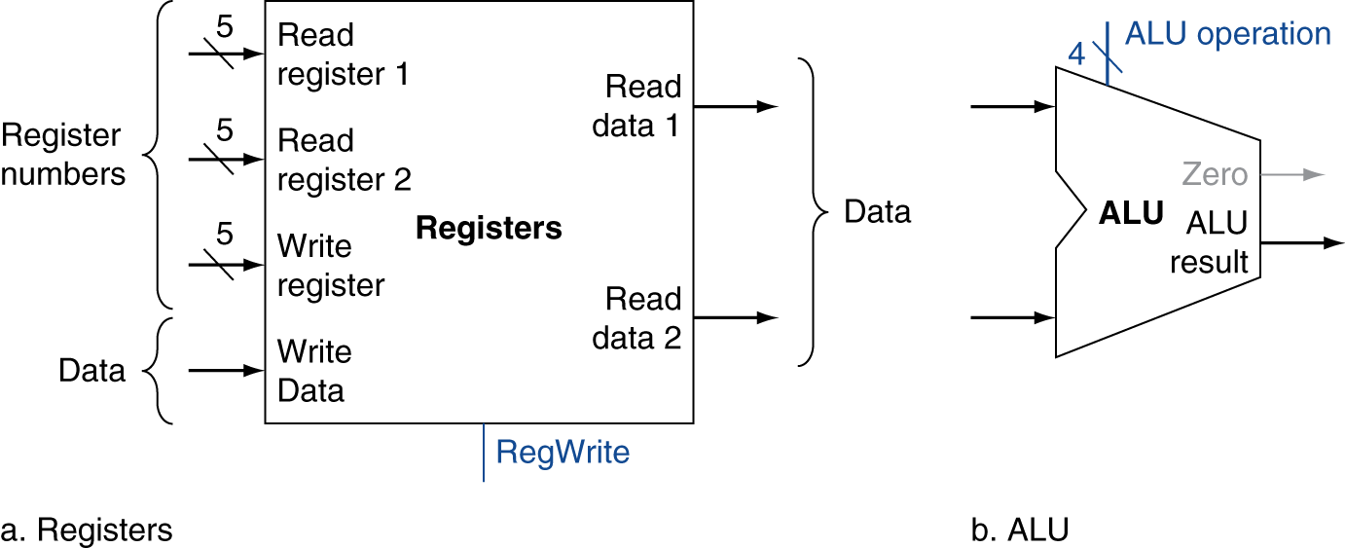
R-Format Instructions
Read two register operands
Perform arithmetic/logical operation
Write register result
Chapter 4 — The Processor — <number>
Notes:
Morgan Kaufmann Publishers
Chapter 4 — The Processor

Slide 6
R-Format Instructions
all read two registers, perform an ALU operation on the contents of the registers, and write the result to a register.
instruction class includes add, sub, AND, OR, and slt.
register file: A state element that consists of a set of registers that can be read and written by supplying a register number to be accessed.
Chapter 4 — The Processor — <number>

Slide 7
R-Format Instructions (Read/ Write)
R-format instructions have three register operands,
  read two data words from and write one data word into - the register file for each instruction.
Reading a data word from registers
  Input: register number to be read
  Output: value that has been read
Writing a data word
  Two inputs: data to be written, and register number where the data to be written.
Chapter 4 — The Processor — <number>

Slide 8
R-Format Instructions (Read/ Write)
need a total of four inputs (three for register numbers and one for data) and two outputs (both for data).
The register number inputs are 5 bits wide to specify one of 32 registers (32 = 2^5), whereas the data input and two data output buses are each 32 bits wide.
Chapter 4 — The Processor — <number>

Slide 9
R-Format Instructions (load/ store)
general form
  lw $t1, offset_value($t2)
  sw $t1,offset_value ($t2).
we will need both the register file and the ALU
Chapter 4 — The Processor — <number>

Slide 10
Load/Store Instructions
Read register operands
Calculate address using 16-bit offset
  Use ALU, but sign-extend offset
Load: Read memory and update register
Store: Write register value to memory
Chapter 4 — The Processor — <number>
Notes:
Morgan Kaufmann Publishers
Chapter 4 — The Processor

Slide 11
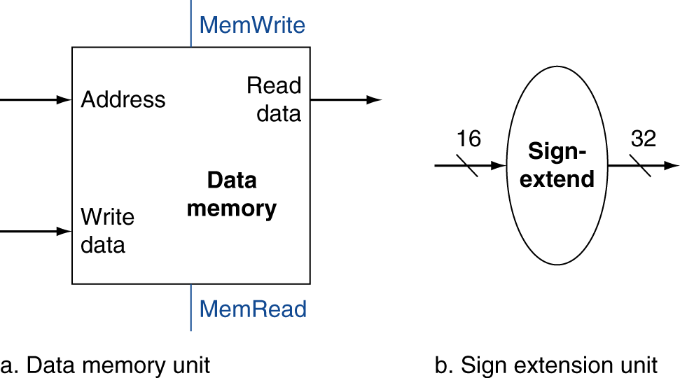
Load/Store Instructions
Two additional units
  sign-extend unit: extend the 16-bit offset field in the instruction to a 32-bit signed value.
  a data memory unit to read from or write to.
    The data memory must be written on store instructions; hence, data memory has read and write control signals, an address input, and an input for the data to be written into memory.
Chapter 4 — The Processor — <number>
Notes:
Morgan Kaufmann Publishers
Chapter 4 — The Processor

Slide 12
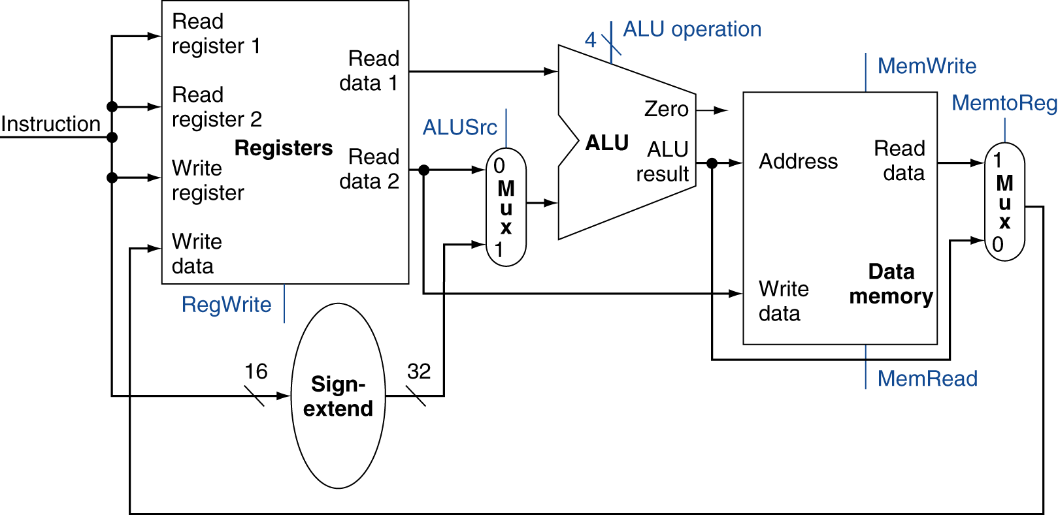
R-Type/Load/Store Datapath
Chapter 4 — The Processor — <number>
Chapter 4 — The Processor — <number>

Slide 13
Branch Instructions
general form: beq $t1,$t2,offset
Read register operands
Compare operands
  Use ALU, subtract and check Zero output
Calculate target address
  Sign-extend displacement
  Shift left 2 places (word displacement)
  Add to PC + 4
    Already calculated by instruction fetch
Chapter 4 — The Processor — <number>
Notes:
Morgan Kaufmann Publishers
Chapter 4 — The Processor

Slide 14
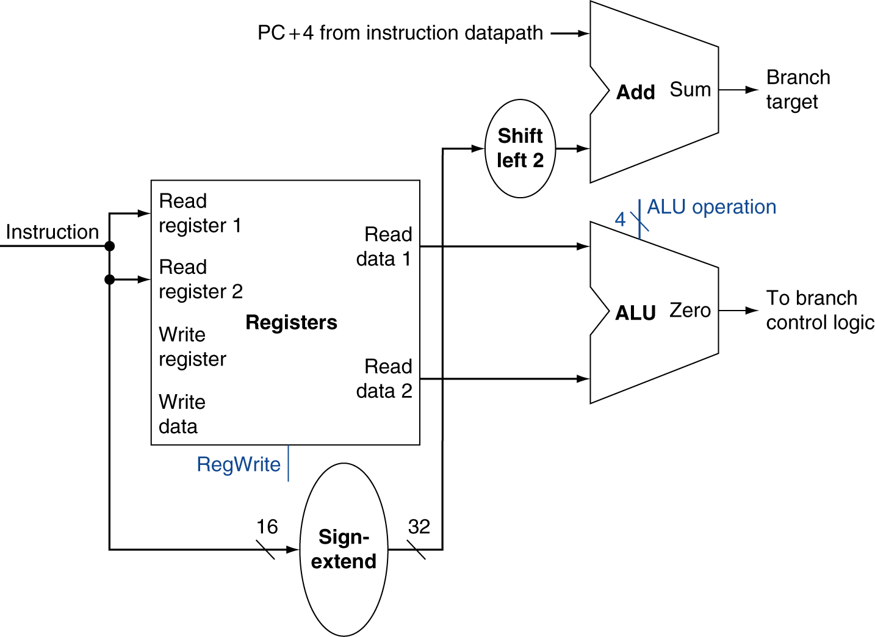
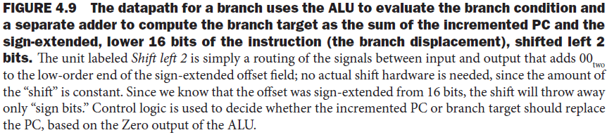
Branch Instructions
Just
re-routes wires
Sign-bit wire replicated
Chapter 4 — The Processor — <number>
Notes:
Morgan Kaufmann Publishers
Chapter 4 — The Processor

Slide 15
Composing the Elements
First-cut data path does an instruction in one clock cycle
  Each datapath element can only do one function at a time
  Hence, we need separate instruction and data memories
Use multiplexers where alternate data sources are used for different instructions
Chapter 4 — The Processor — <number>
Notes:
Morgan Kaufmann Publishers
Chapter 4 — The Processor

Slide 16
R-Type/Load/Store Datapath
Chapter 4 — The Processor — <number>
Notes:
Morgan Kaufmann Publishers
Chapter 4 — The Processor

Slide 17
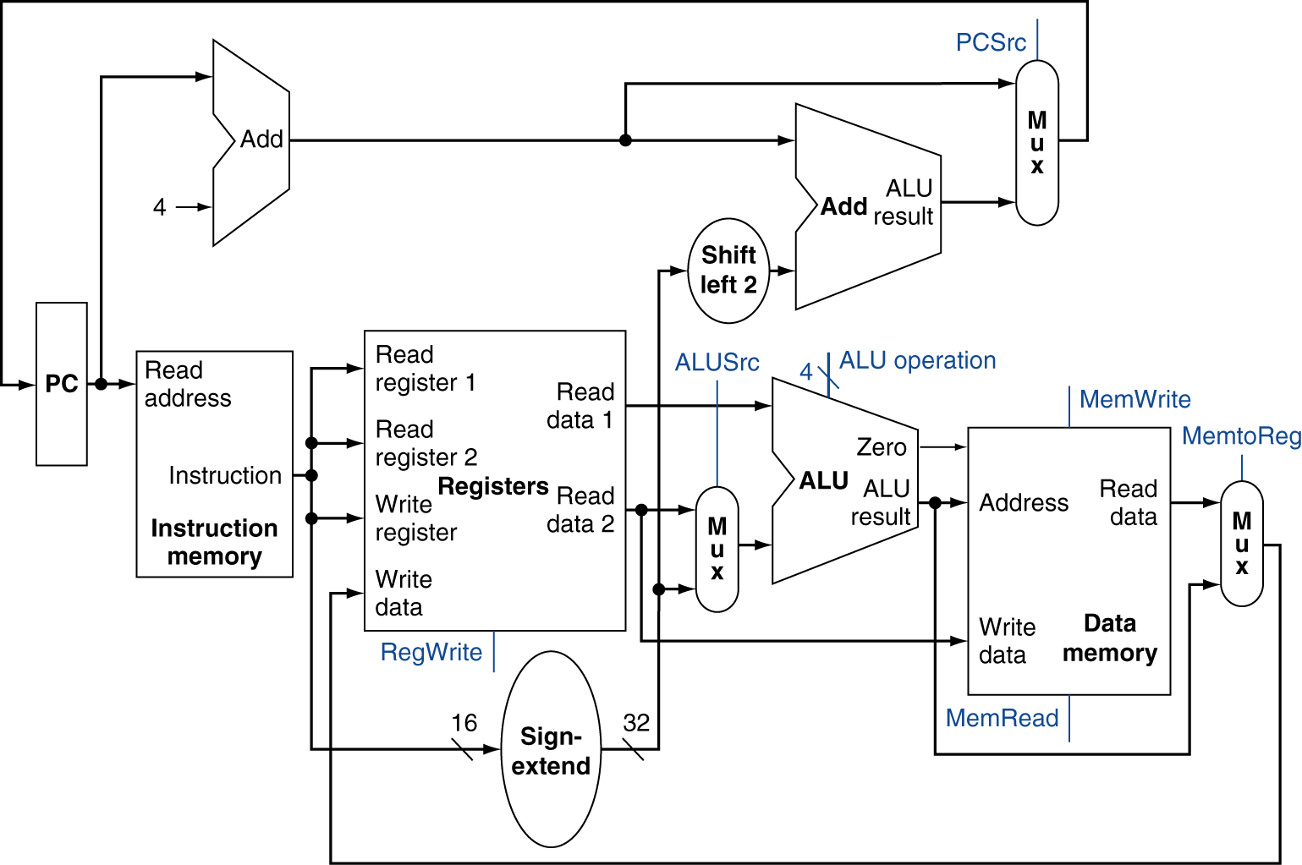
Full Datapath
Chapter 4 — The Processor — <number>
Notes:
Morgan Kaufmann Publishers
Chapter 4 — The Processor

Slide 18
ALU Control
ALU used for
  Load/Store: F = add
  Branch: F = subtract
  R-type: F depends on funct field
§4.4 A Simple Implementation Scheme
ALU control | Function
0000 | AND
0001 | OR
0010 | add
0110 | subtract
0111 | set-on-less-than
1100 | NOR
Chapter 4 — The Processor — <number>
Notes:
Morgan Kaufmann Publishers
Chapter 4 — The Processor

Slide 19
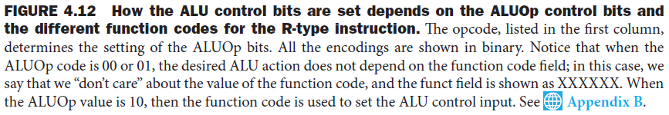
ALU Control
Assume 2-bit ALUOp derived from opcode
  Combinational logic derives ALU control
opcode | ALUOp | Operation | funct | ALU function | ALU control
lw | 00 | load word | XXXXXX | add | 0010
sw | 00 | store word | XXXXXX | add | 0010
beq | 01 | branch equal | XXXXXX | subtract | 0110
R-type | 10 | add | 100000 | add | 0010
 |  | subtract | 100010 | subtract | 0110
 |  | AND | 100100 | AND | 0000
 |  | OR | 100101 | OR | 0001
 |  | set-on-less-than | 101010 | set-on-less-than | 0111
Chapter 4 — The Processor — <number>
Notes:
Morgan Kaufmann Publishers
Chapter 4 — The Processor

Slide 20
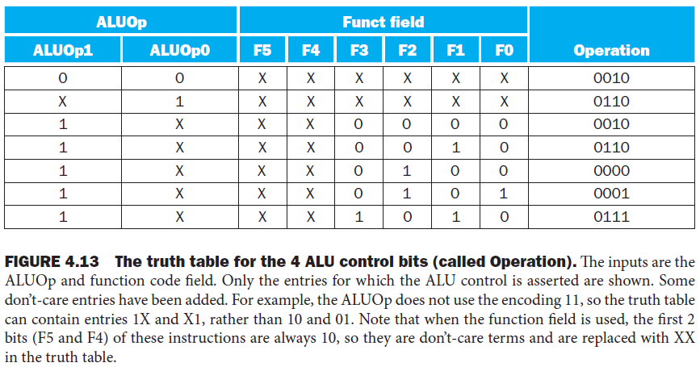
Designing the Main Control Unit
Chapter 4 — The Processor — <number>

Slide 21
The Main Control Unit
Control signals derived from instruction
R-type
0
rs
rt
rd
shamt
funct
31:26
25:21
20:16
15:11
10:6
5:0
Load/
Store
35 or 43
rs
rt
address
31:26
25:21
20:16
15:0
Branch
4
rs
rt
address
31:26
25:21
20:16
15:0
opcode
always read
read, except for load
write for R-type and load
sign-extend and add
Chapter 4 — The Processor — <number>
Notes:
Morgan Kaufmann Publishers
Chapter 4 — The Processor

Slide 22
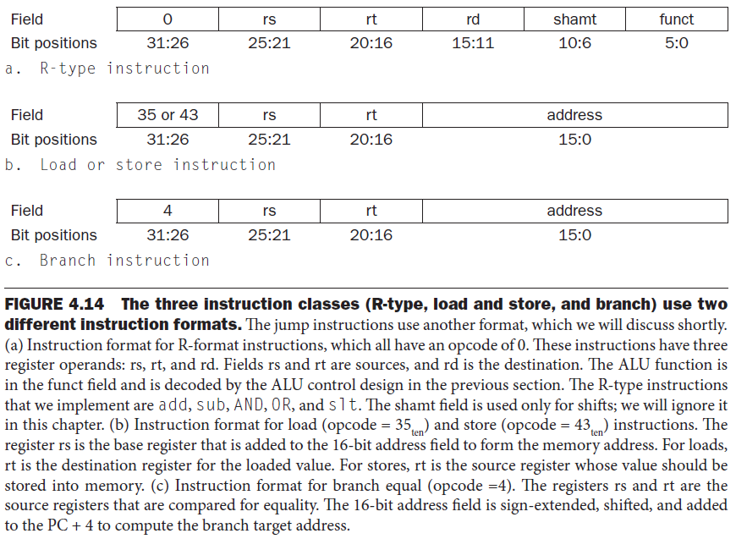
The Main Control Unit
Chapter 4 — The Processor — <number>
Notes:
Morgan Kaufmann Publishers
Chapter 4 — The Processor

Slide 23
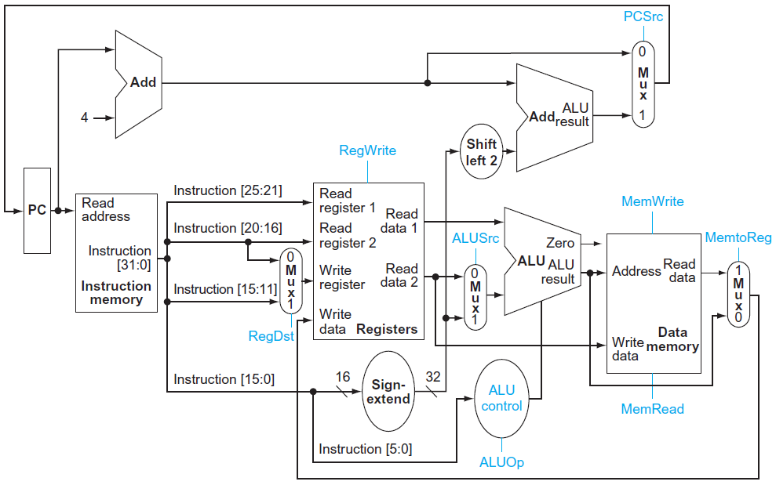
Datapath With Control
Chapter 4 — The Processor — <number>
Notes:
Morgan Kaufmann Publishers
Chapter 4 — The Processor

Slide 24
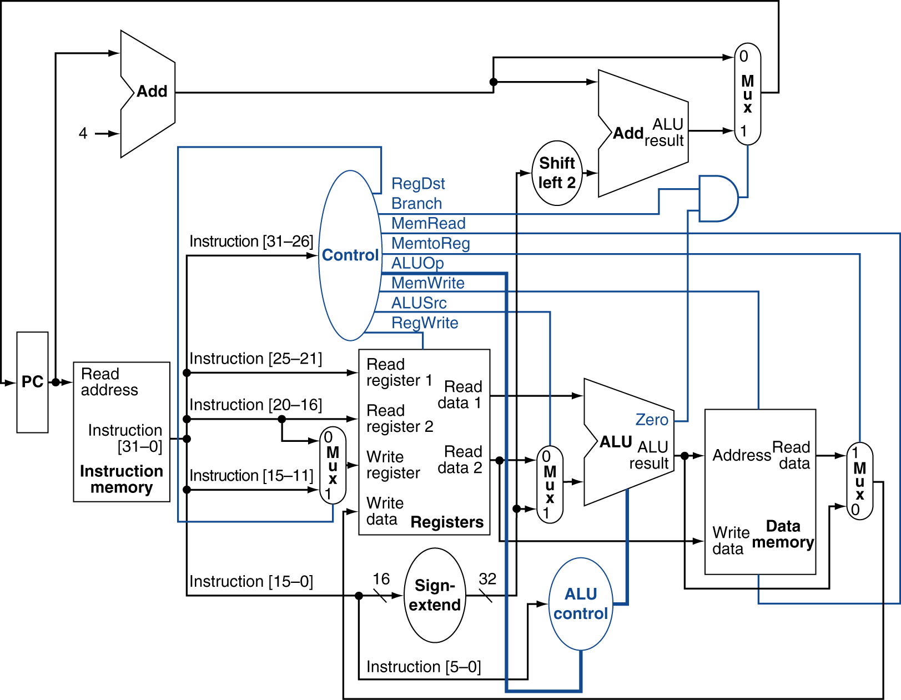
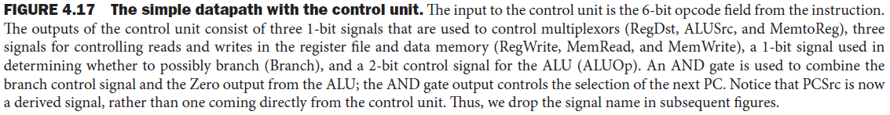
Datapath With Control
Chapter 4 — The Processor — <number>
Notes:
Morgan Kaufmann Publishers
Chapter 4 — The Processor

Slide 25
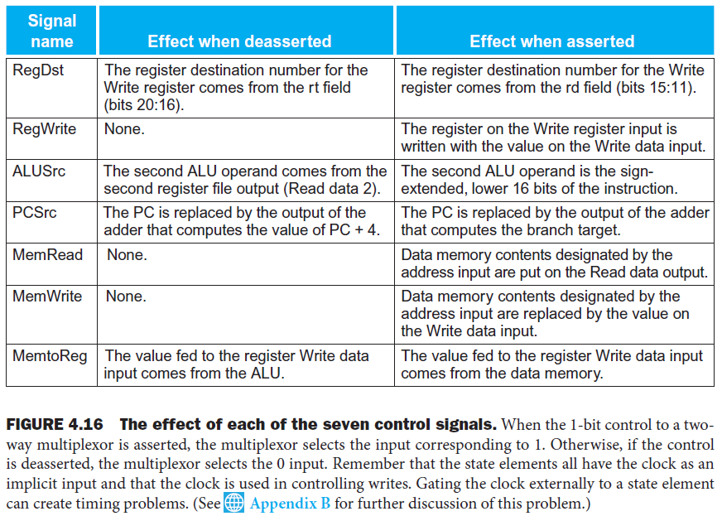
The Main Control Unit
Chapter 4 — The Processor — <number>

Slide 26
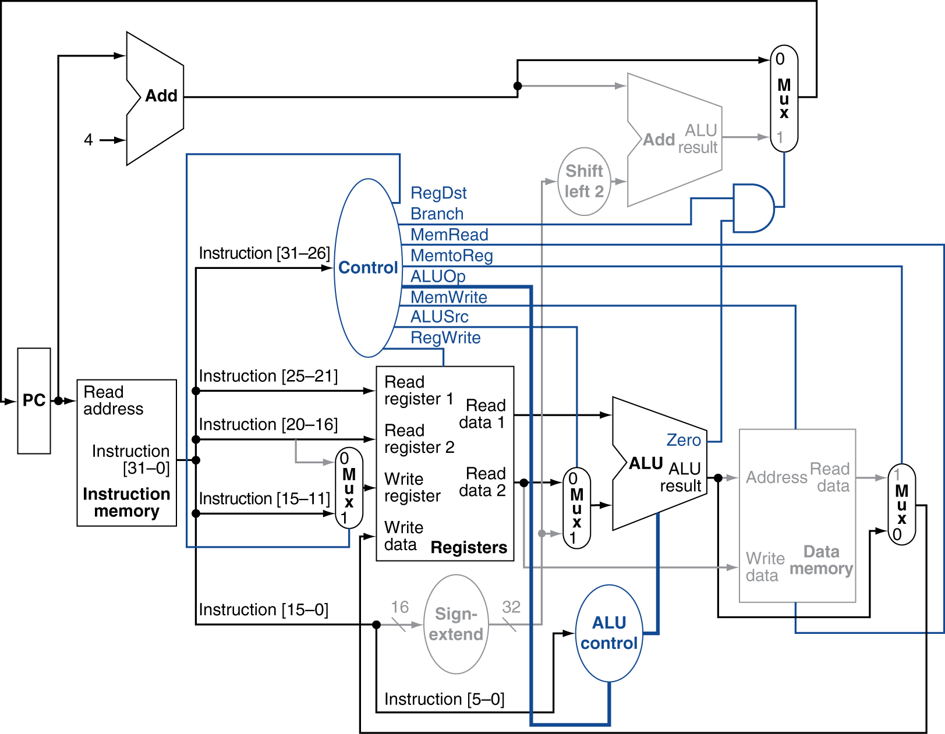
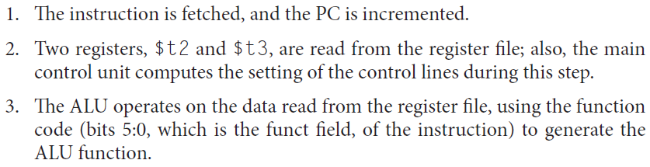
R-Type Instruction
Chapter 4 — The Processor — <number>
Notes:
Morgan Kaufmann Publishers
Chapter 4 — The Processor

Slide 27
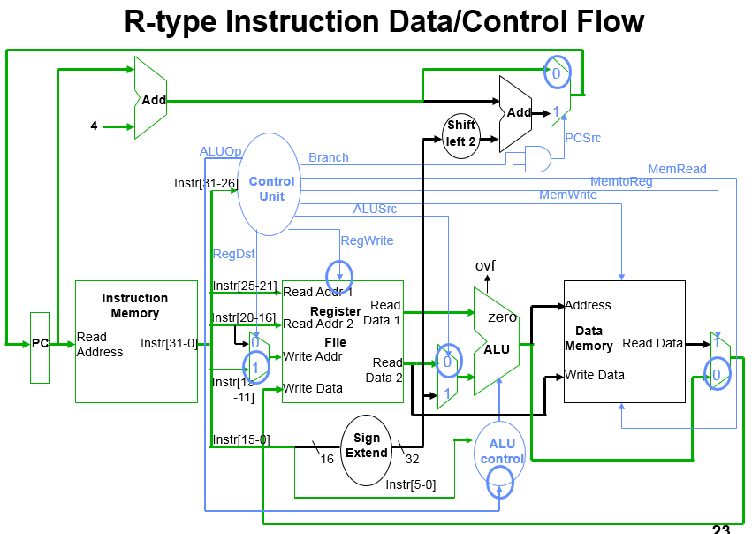
Chapter 4 — The Processor — <number>

Slide 28
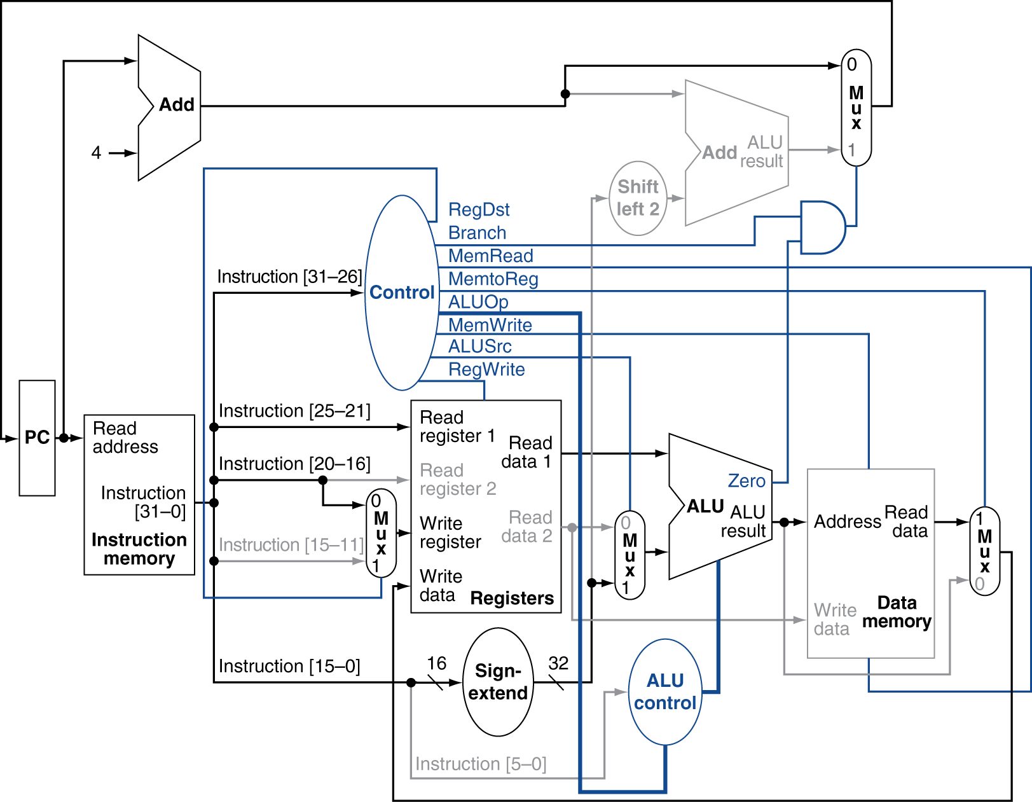
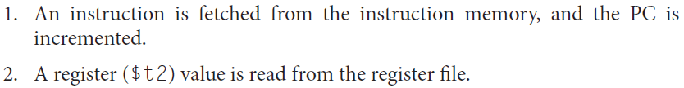
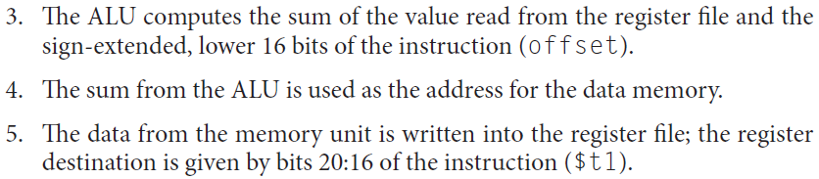
Load Instruction
Chapter 4 — The Processor — <number>
Notes:
Morgan Kaufmann Publishers
Chapter 4 — The Processor

Slide 29
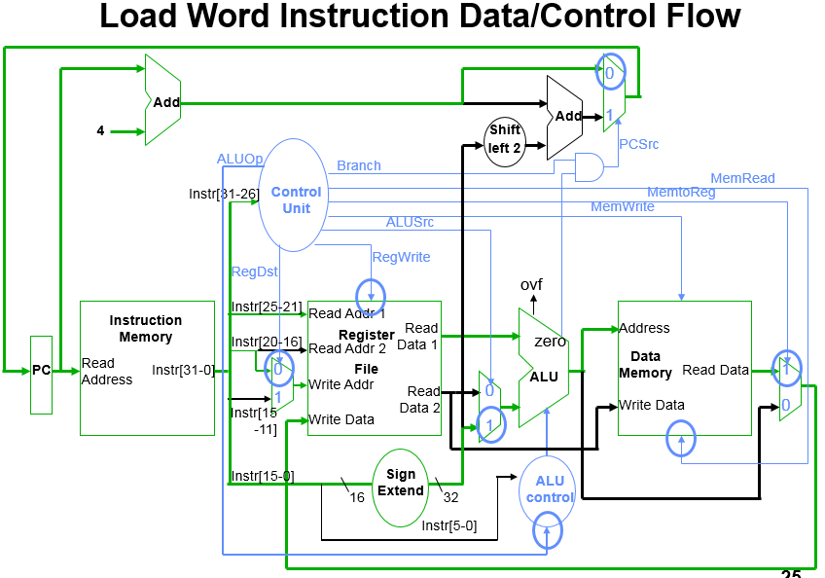
Chapter 4 — The Processor — <number>

Slide 30
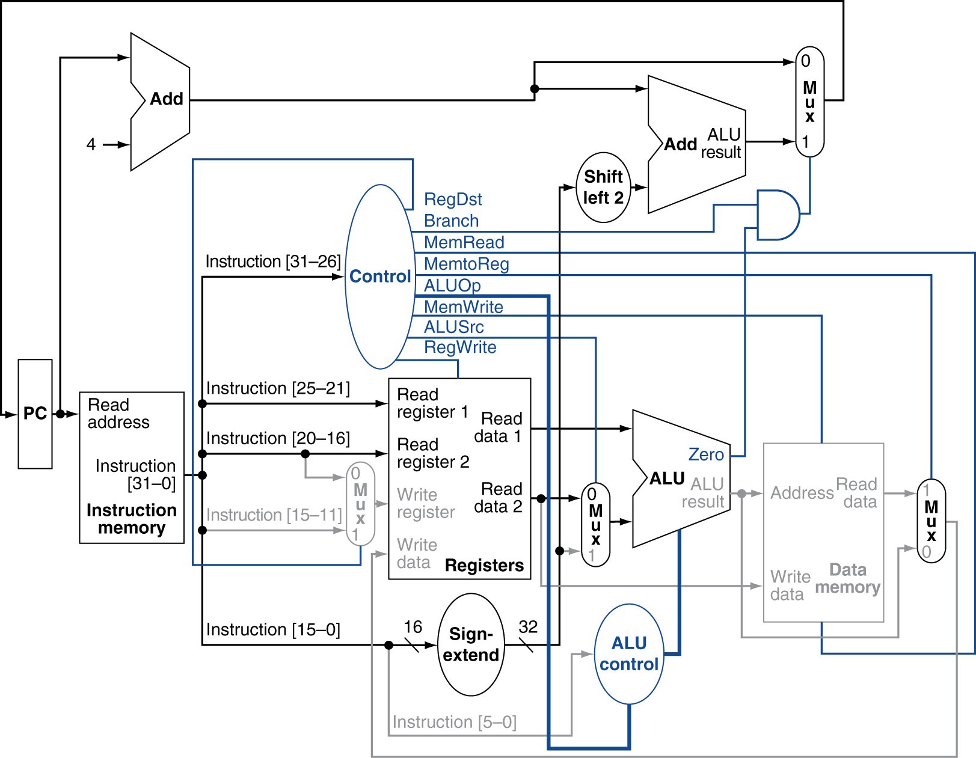
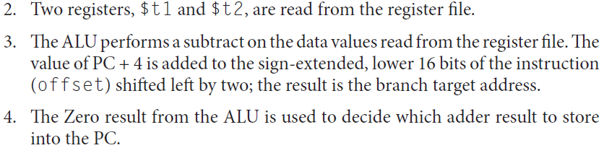
Branch-on-Equal Instruction
Chapter 4 — The Processor — <number>
Notes:
Morgan Kaufmann Publishers
Chapter 4 — The Processor

Slide 31
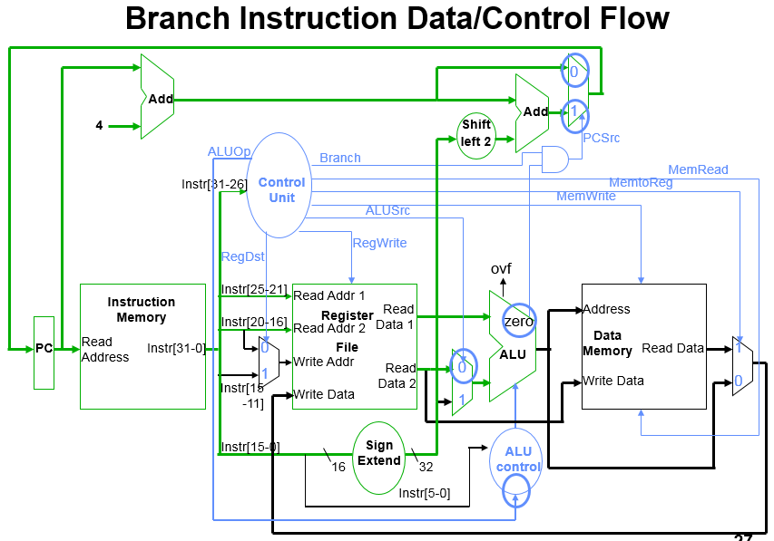
Chapter 4 — The Processor — <number>

Slide 32
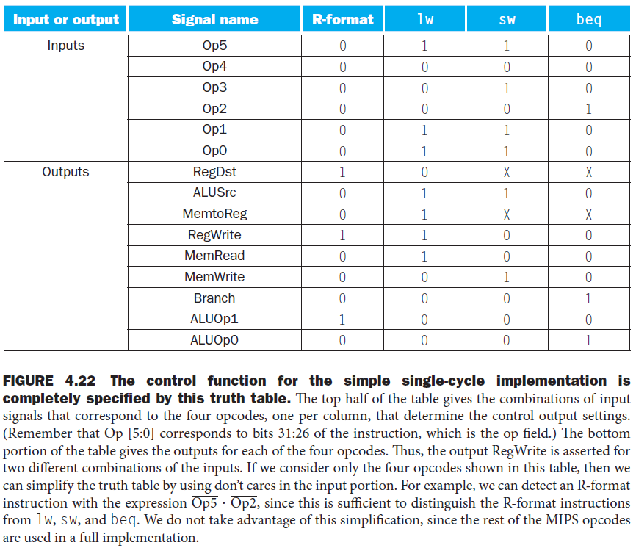
Finalizing Control
Chapter 4 — The Processor — <number>

Slide 33
Implementing Jumps
Jump
2
address
31:26
25:0
Jump uses word address
Update PC with concatenation of
  Top 4 bits of PC+4
  26-bit jump address
  00
Need an extra control signal decoded from opcode
Chapter 4 — The Processor — <number>
Notes:
Morgan Kaufmann Publishers
Chapter 4 — The Processor

Slide 34
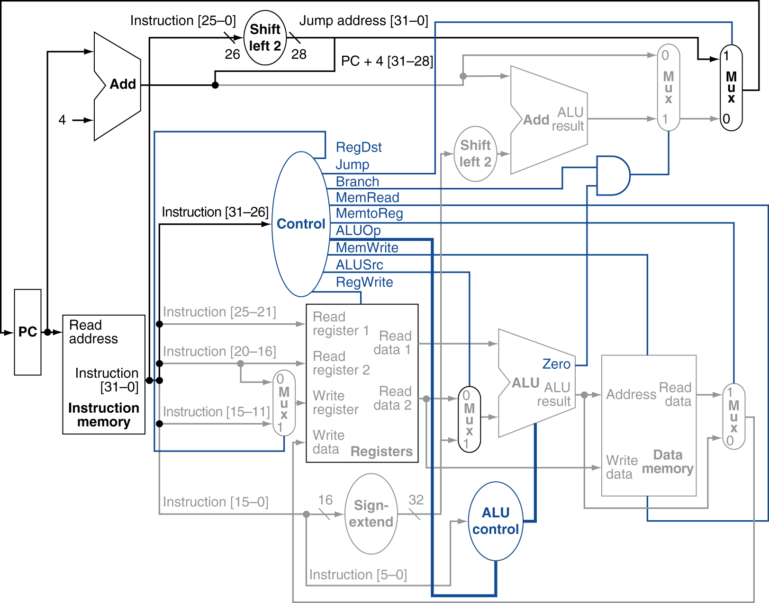
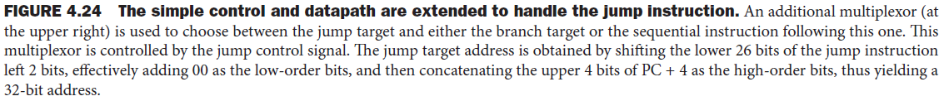
Datapath With Jumps Added
Chapter 4 — The Processor — <number>
Notes:
Morgan Kaufmann Publishers
Chapter 4 — The Processor

Slide 35
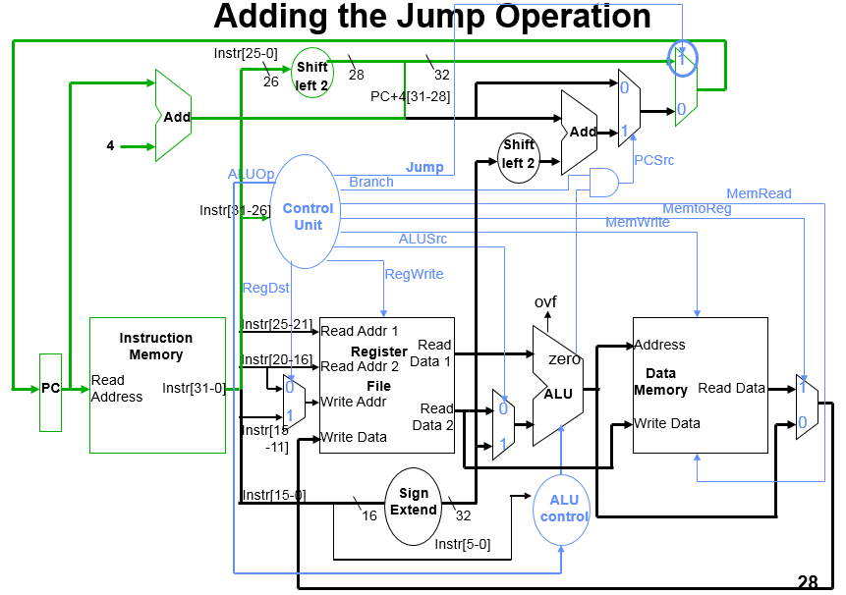
Chapter 4 — The Processor — <number>

Slide 36
Performance Issues
Longest delay determines clock period
  Critical path: load instruction
  Instruction memory → register file → ALU → data memory → register file
Not feasible to vary period for different instructions
Violates design principle
  Making the common case fast
We will improve performance by pipelining
Chapter 4 — The Processor — <number>
Notes:
Morgan Kaufmann Publishers
Chapter 4 — The Processor

